Slide 1
HSE Safer Nightlife
MDMA awareness
Partner Pack
December 2025

Slide 2
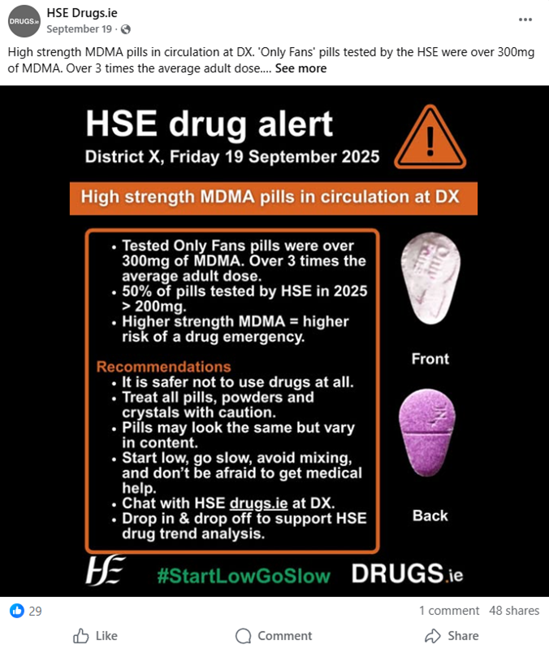
MDMA
Overview
Please help raise awareness this Christmas by sharing our messages and available resources: social media images and messages, leaflets, posters and videos.
The HSE has found that MDMA in Ireland has become much stronger and more unpredictable, with some pills and powders containing far higher amounts than expected.
This makes it easier to take too much without realising and increases the risk of serious harm.
People should be extra cautious; avoid mixing drugs or alcohol, start low and go slow if they choose to use, and pay attention to health warnings from the HSE.

Slide 3
Background
It's always safer not to use drugs at all.
We want you and your friends to stay safe and reduce the harms if you choose to use drugs this Christmas.
The HSE is the only agency analysing MDMA strength in Ireland to help you reduce harm.
HSE drug checking has found pills containing anywhere from 0mg to over 300mg of MDMA this year. The average adult dose is around 80mg -125mg, so some products are over 3 times the typical dose.
One pill does not equal one dose.
Treat all pills, powders and crystals with caution.
Higher-strength pills, powders and crystals increase the risk of an emergency.

Slide 4
Harm reduction messages
How you can mind yourself and others
It is safer not to use drugs at all, if you do…
Start low, go slow and leave at least 2 hours before taking more.
Use one drug at a time. Mixing with other drugs including alcohol, over the counter and prescription medication increases the risks.
Keep cool, stay hydrated but don’t drink over a pint of water an hour.
Plan a safe way home. Don’t drive after using drugs, they can still be detected even if you don’t feel the effects.
Look after your community, be a good bystander, make sure no one is left alone
Know the signs of an emergency: pains in arms, legs, muscle twinges, overheating, being warm to touch, confusion, seizure.
Don’t delay getting help & medics are your mates.

Slide 5
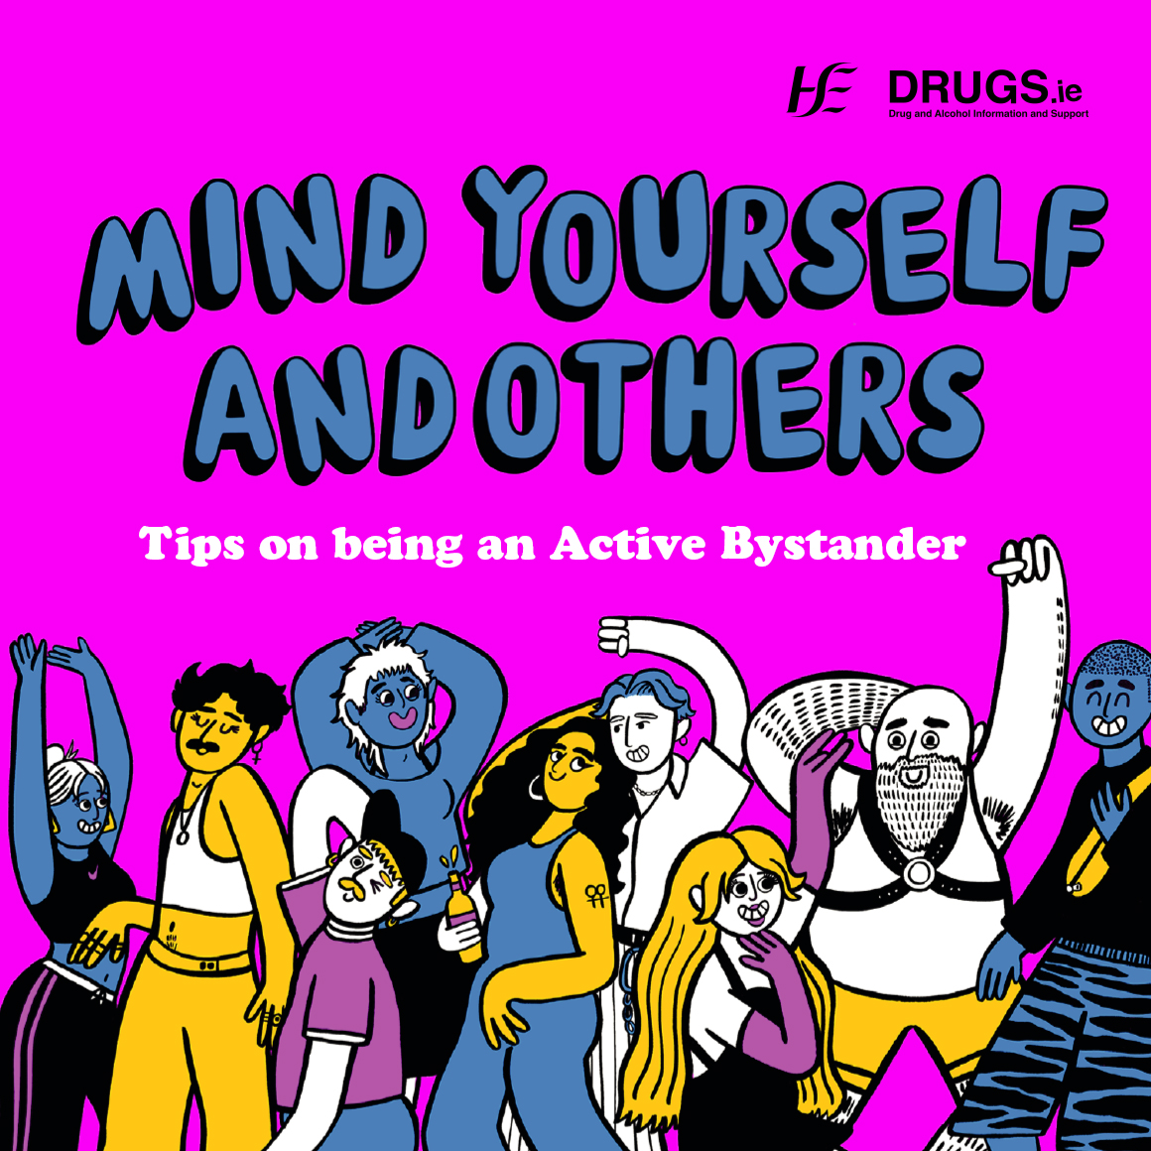
Social Media
Messaging
We’d be grateful if you could share these messages and images on your social platforms this Christmas.
0:00 / 0:36
Let's act together for safer nights out. No matter what setting, be a good bystander, mind yourself and others.
Read more about being an active bystander: https://tinyurl.com/ymw6fnue

Slide 6
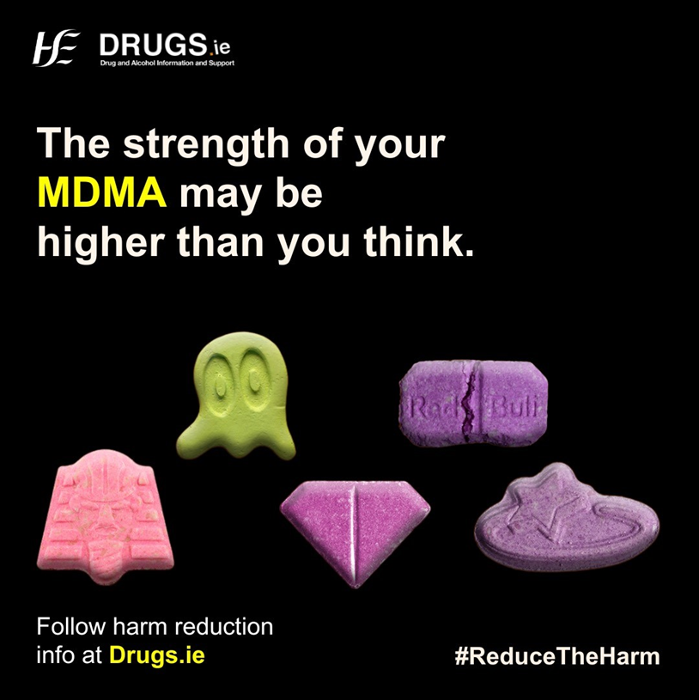
Social Media
Messaging
MDMA products are getting stronger. Higher strength means higher risk.
Reduce risk by following these tips:
Start with a low dose and go slow, whether it’s pills, powders, or crystals.
Stay hydrated, but limit water to a pint per hour.
Take breaks when dancing to prevent overheating.
Hashtags
#StartLowGoSlow #ReduceTheHarms #MedicsAreYourMates
Website link to further information: tps://www.drugs.ie/drugtypes/drug/ecstasy

Slide 7
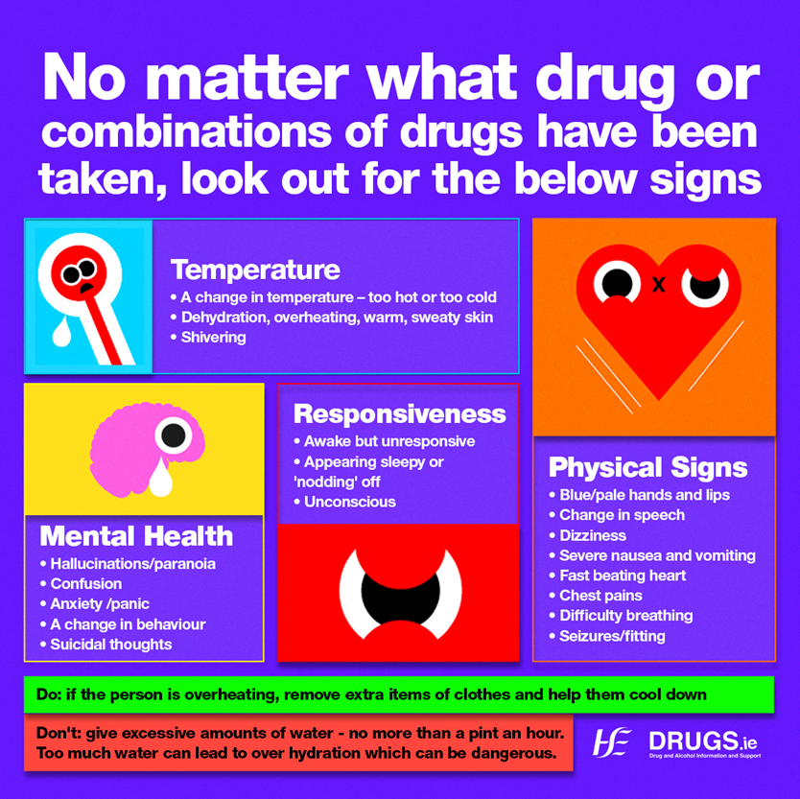
Social Media
Messaging
Do you know the signs of an MDMA emergency?
Look out for overheating, confusion, fast heartbeat, pains in legs/arms.
If in doubt, get it checked out. Find out more at drugs.ie/KnowingtheSigns
#StartLowGoSlow
#ReduceTheHarms
#MedicsAreYourMates

Slide 8
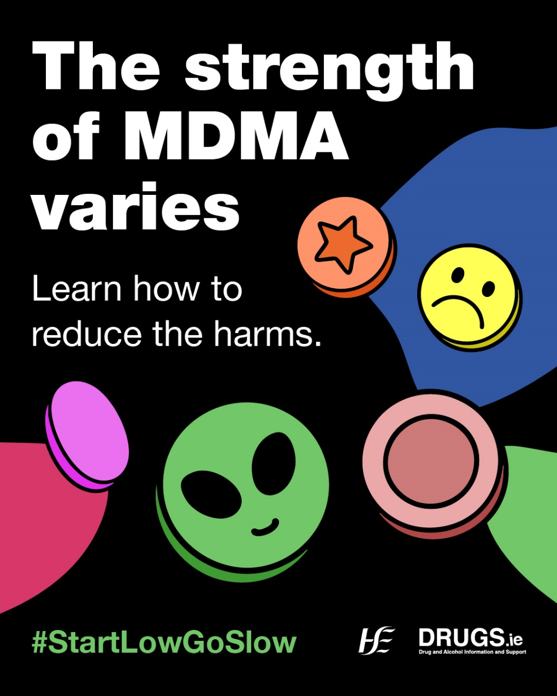
Social Media
Messaging
This year, the HSE drug checking service has shown us that the MDMA market is changing.
Pills, powders, and crystals now contain more MDMA than before.
The HSE identified a pill containing 312mg of MDMA, which is the highest ever seen in Ireland.
Higher doses increase the risk of overdose, leading to serious medical emergencies or even death.
Hashtags
#StartLowGoSlow #ReduceTheHarms #MedicsAreYourMates
Website link to further information: https://www.drugs.ie/drugtypes/drug/ecstasy

Slide 9
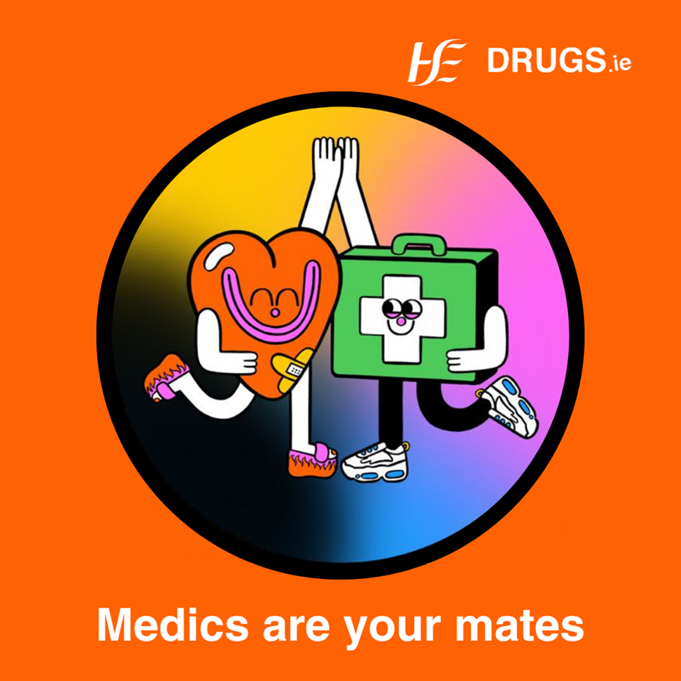
Social Media
Messaging
The MDMA market has changed.
One pill doesn’t always mean one dose, and powders aren't automatically a safer option.
Higher strength is higher risk and it is always safer not to use at all.
Know the warning signs of an MDMA emergency and never hesitate to get help.
Hashtags
#StartLowGoSlow #ReduceTheHarms #MedicsAreYourMates
Website link to further information: https://www.drugs.ie/drugtypes/drug/ecstasy

Slide 10
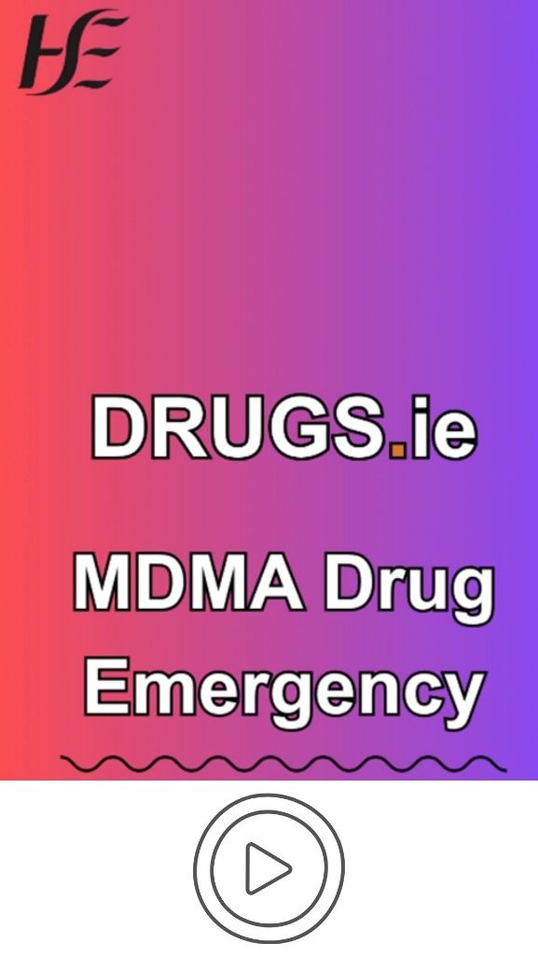
MDMA Videos
Two short, subtitled videos for social media featuring HSE Emerging Drug Trend manager Nicki Killeen.
These videos focus on the risks around high strength MDMA and how to spot the signs of an MDMA overdose.
Link to videos:
https://youtube.com/shorts/wwfbgn95_QQ
https://youtube.com/shorts/xgt8wl860zk

Slide 11
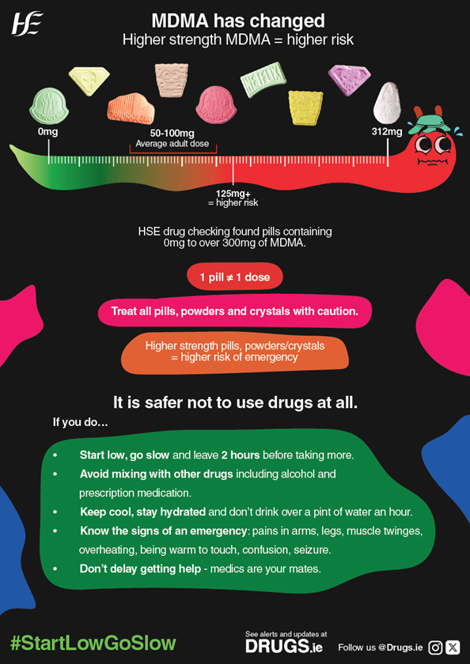
Resources: MDMA Poster
This HSE poster sets out the risks associated with high strength MDMA and the steps you can take to reduce the harms.
To order this poster contact:
Drugs.ie@hse.ie

Slide 12
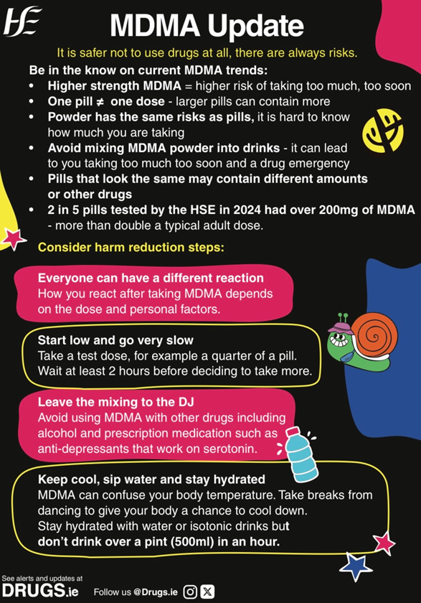
Resources: MDMA Leaflet
This HSE leaflet sets out the risks associated with high strength MDMA and the steps you can take to reduce the harms.
To order this leaflet contact:
Drugs.ie@hse.ie

Slide 13
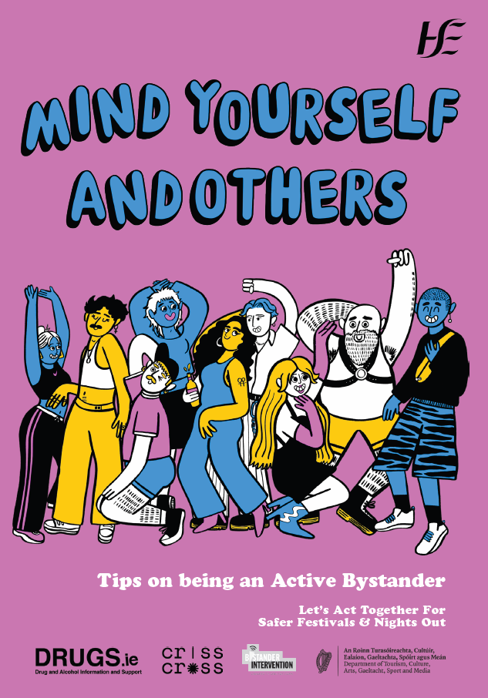
Resources: HSE ‘Tips on being an Active Bystander’ leaflet
We can all have a role in creating safer and more inclusive spaces by looking out for ourselves and others.
This is a guide to being an ‘active bystander’ . It gives practical advice on how to notice when someone might need help and how to intervene safely.
To order this leaflet contact: Drugs.ie@hse.ie
Download: https://tinyurl.com/ymw6fnue

Slide 14
Resources: MDMA Videos
Two short, subtitled videos for social media featuring HSE Emerging Drug Trend manager Nicki Killeen.
These videos focus on the risks around high strength MDMA and how to spot the signs of an MDMA overdose.
Link to videos:

Slide 15
Contact Information
Thank you for sharing this campaign.
For queries, please contact: drugs.ie@hse.ie
Dr Eamon Keenan National Clinical Lead, Addiction Services
Nicki Killeen Emerging Drug Trends Project Manager

Slide 16
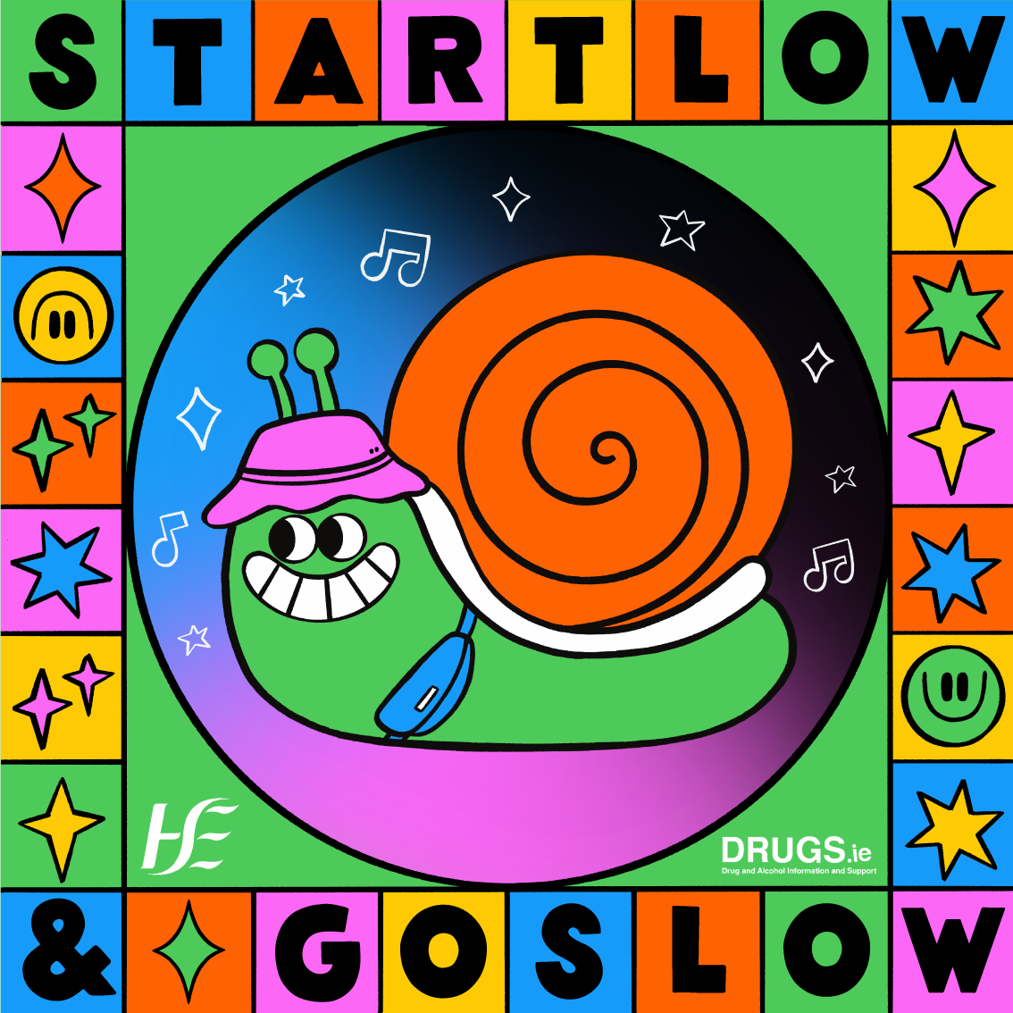
More Social Media
Assets

Slide 17

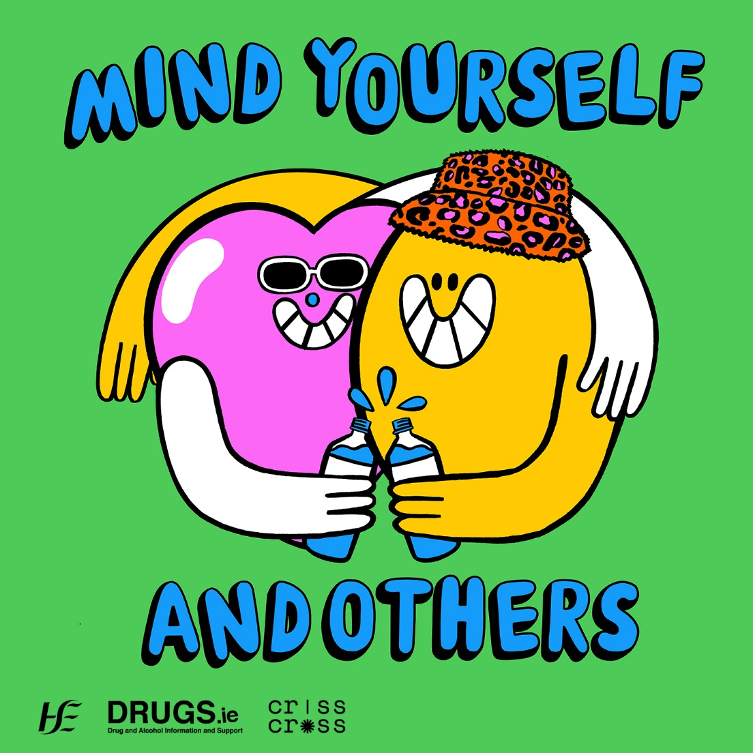
Social Media
Assets

Slide 18

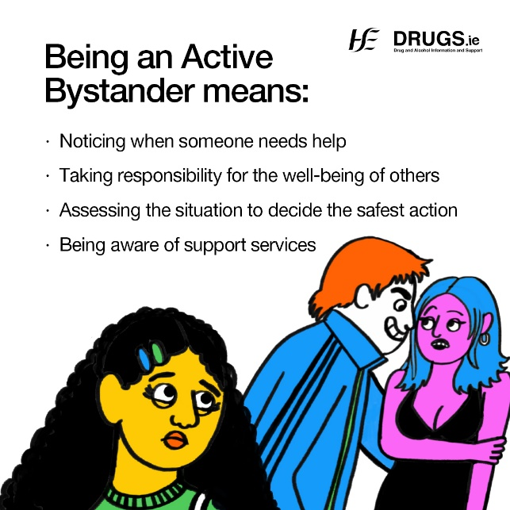
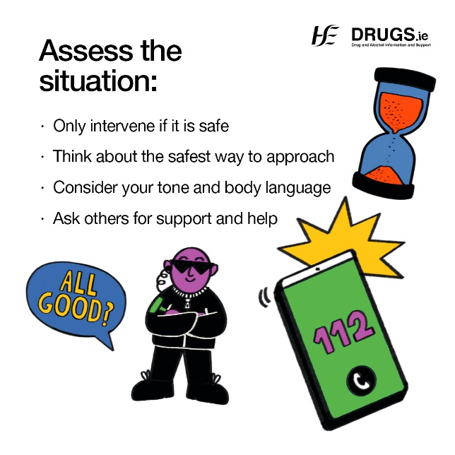
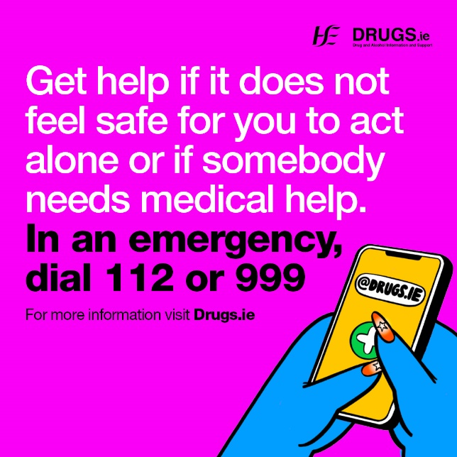
Social Media
Tips on being an Active Bystander social media images

